Slide 1
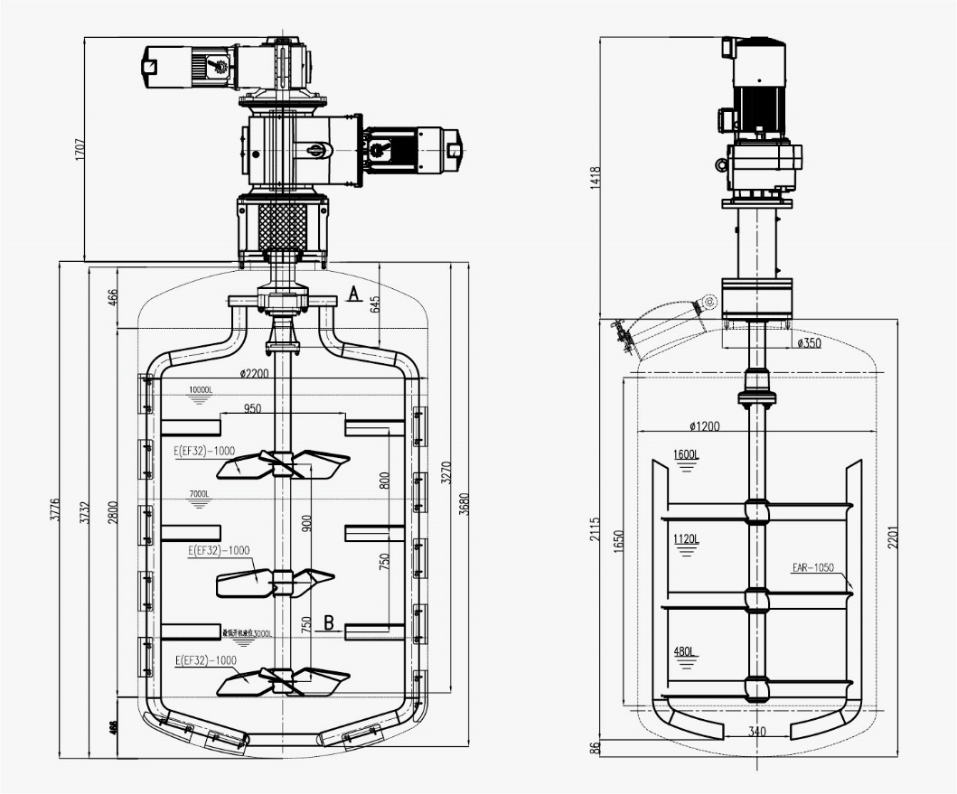
Chemical Industry
Cleansing and Skincare Application Solutions
Background
Cleansing and skincare products are among the most common and widely used product categories in the daily chemical industry. They are designed to remove dirt, oil, and cosmetic residues from the skin surface, replenish skin moisture, balance skin pH, refine pores, and provide deep repair for specific skin concerns. These products are used frequently in daily life, and their functional positioning and product forms vary significantly across different applications.

Slide 2
Chemical Industry
Cleansing and Skincare Application Solutions
Customer Profile
Material and Operating Condition Description
A leading multinational group company specializing in laundry and home care products, beauty care products, and adhesive technologies. Its portfolio of brands serves both consumer and industrial markets, providing high-quality products and a wide range of solutions.
Material Composition: Shampoo
Operating Conditions:
◆ 10 m³ slender vessel with high sanitary requirements
◆ Material viscosity above 10,000 cP, requiring mixing, dispersion, and dissolution of a high-viscosity system
◆ Operation under both positive pressure and vacuum conditions
Value Proposition
Key Problems Addressed
Meets the customer’s batch production quality requirements, including but not limited to particle size, batch-to-batch consistency, and production time.
Large-scale coaxial agitation system with a processing capacity of up to 10 m³.
1. Meet batch production requirements
2. Ensure the longest possible maintenance interval for overseas operation
3. Aseptic-grade design to meet high cleanliness requirements

Slide 3

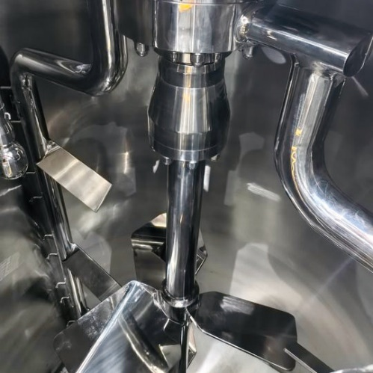
Chemical Industry
Cleansing and Skincare Application Solutions
Solution
Equipment Name: Mechanical Agitator
Equipment Model: EUMIX-15 & EUMIX-22
Speed Range: 7–71 rpm & 2–21 rpm
Working Configuration:
Coaxial inner shaft — EF32 three-stage impeller
Coaxial outer shaft — EFR34
Wetted Parts Material: SS316, Ra ≤ 0.4 μm
Non-wetted Parts Material: SS304, Ra ≤ 1.2 μm, polished
◆ Coaxial dual-speed mixing: the outer scraper prevents material from sticking to the vessel wall, while the inner three-stage impeller improves dissolution and mixing, ensuring full coverage with no dead zones.
◆ Hygienic design and high manufacturing standards to meet sanitary requirements.
Results
1. Efficient Mixing with No Dead Zones: Two impeller designs work together to provide multi-level mixing and full spatial coverage.
2. High Sanitary Standard:Hygienic design ensures easy cleaning with no dead zones.
3. Reliability and Compliance:The design combines theoretical calculation with practical experience, ensuring reliable performance with complete documentation and certifications.

